Slide 1
Initial Expedition Training Learning Outcome 3 Food and Cooking
Uncontrolled copy not subject to amendment
Version 2.0 OCT 2014

Slide 2
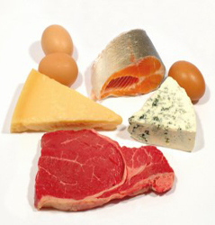
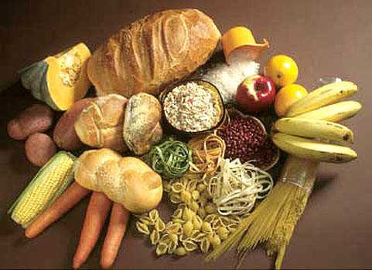
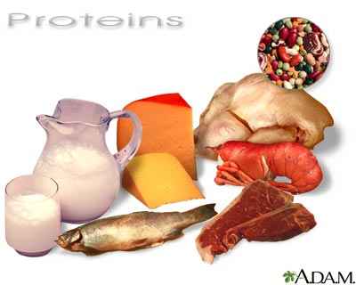
Calories
Fat sources
Protein
Carbohydrates
Notes:
Instructor Notes
Cadets often don’t eat well in normal life. In expedition environments it is very important that they eat well. A good breakfast of slow release energy is vital if they are to stay alert and enjoy their day.
When cadets start to run short of energy their navigation suffers, their enjoyment decreases and they become more susceptible to hypothermia.
It is important that they bring snacks to maintain the most even blood sugar level possible by slow grazing during the day.
The evening meal should be cooked and cadets should be encouraged to find something that they like to eat that contains a good level of calories.
Hygiene is important and cadets have been taken to hospital with food poisoning. Insist that they wash their hands when possible.

Slide 3
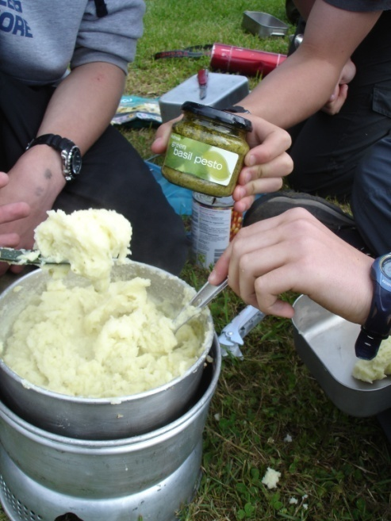
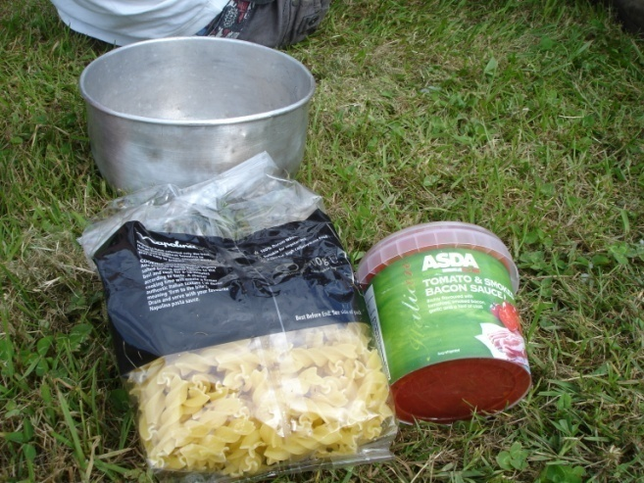
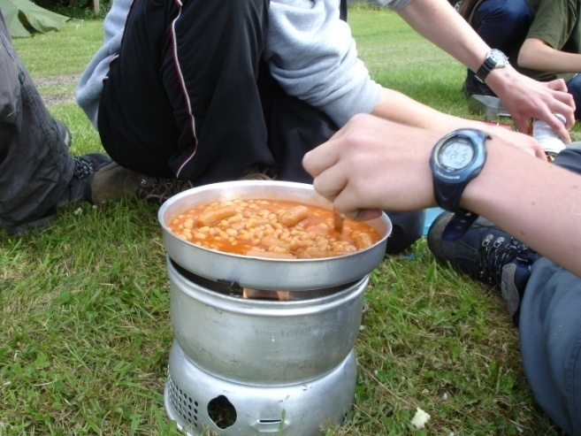
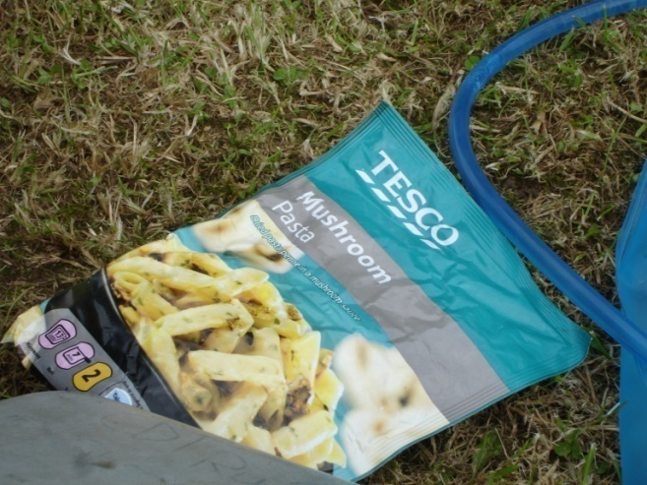
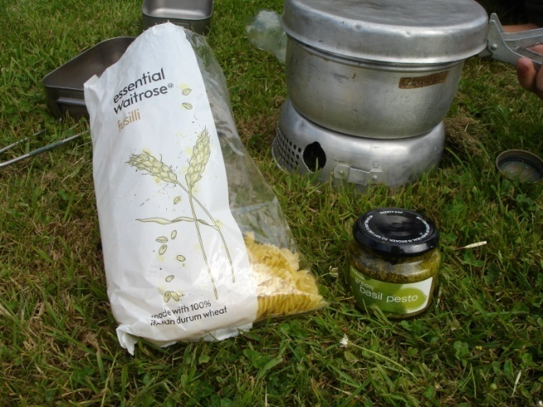
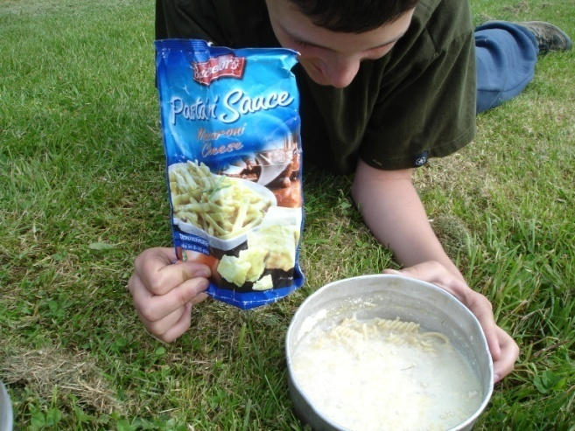
Some tasty examples
Notes:
Some of this looks stodgy, but none of this is ration packs, so the cadets made an effort to get out to the supermarket and choose. It was their choice and they seemed to enjoy it. Both the food and the cadets certainly had lots of energy.

Slide 4
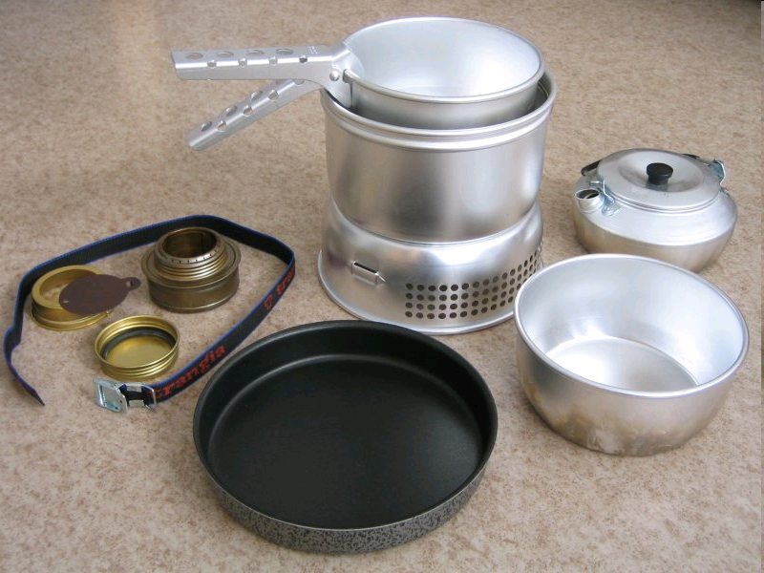
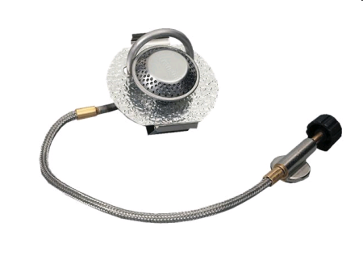
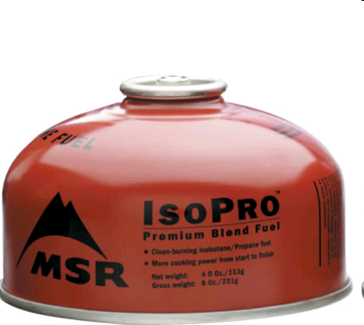
Trangiers are easy to use and MSR gas works well
when the weather cold
Notes:
Instructor notes
Meths should be stored in a red spring valve bottle designed for meths fuel.
Do not allow the cadets to carry meths fuel to a stove. Always insist that they carry the stove insert to the fuel. If they cannot hold the insert, it’s too hot to refuel.
There are many makes of gas and many sizes of canister – MSR gas works particularly well when it’s cold and doesn’t cost any more than other fuel mixtures.

Slide 5
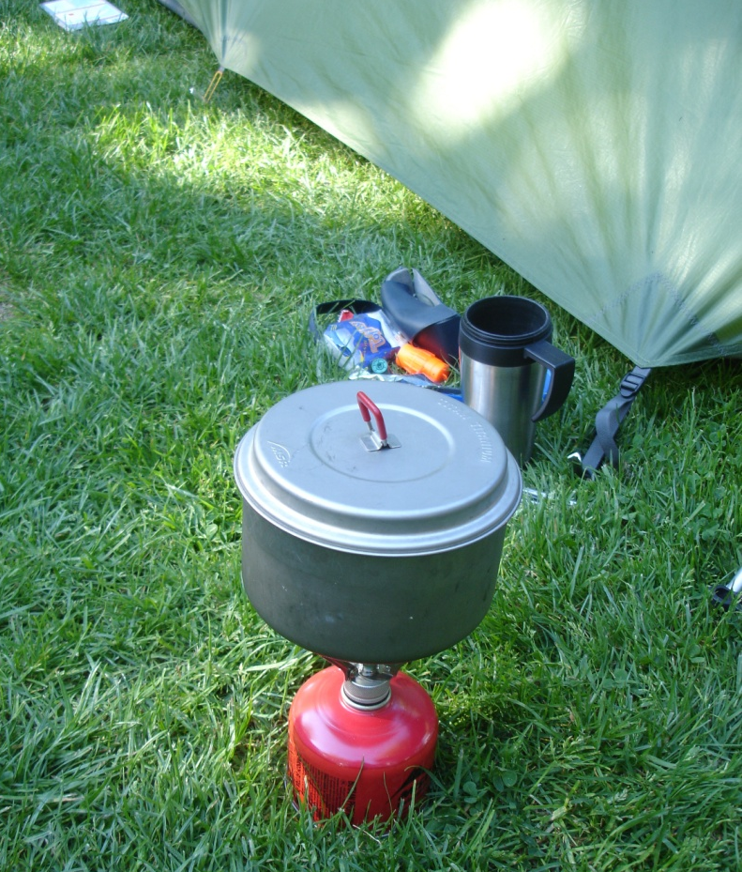
Smaller stoves for more advanced use
A pocket rocket in action!
Notes:
Instructor Notes
Stoves like this are not very stable and probably not recommended for junior cadets. They are probably not needed for expeditions where a team carries the heavier trangier between them. For lightweight wild camping by ML candidates they are useful.
This type of stove will struggle in windy conditions.

Slide 6
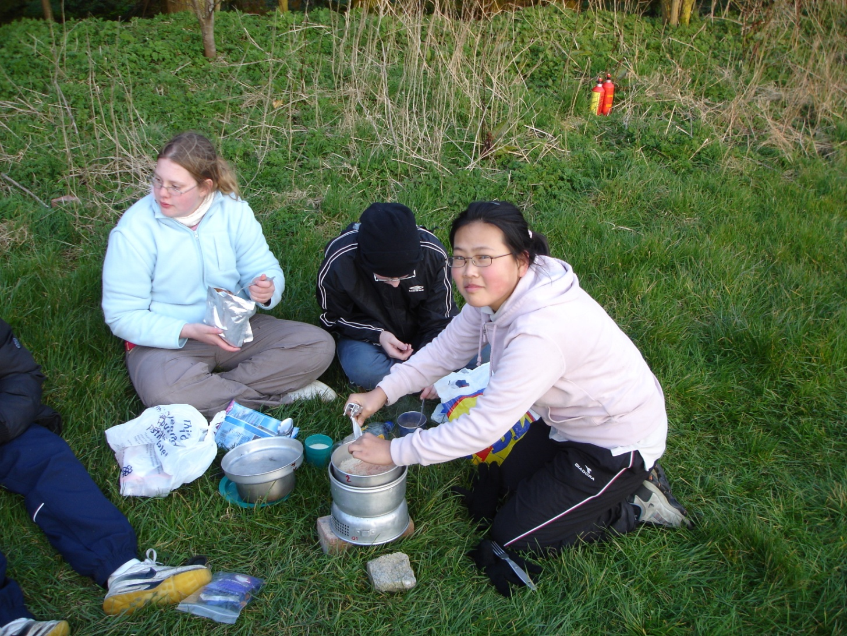
Practical session: cooking competition.
Notes:
Instructor Notes
Spend some time with the cadets talking about what they think they might like to cook and eat on their expedition. Then ask them to come in next week with their food. Each cadet can cook the food they’ve brought and the best food will win. Encourage them to try each others food. This is quite useful exercise – e.g. many parents will buy dehydrated rations from the camp store, but a lot of cadets don’t actually like them.

